Slide 1
IMAGE CLASSIFICATION
BY:ZEENAT WASEEM

Slide 2
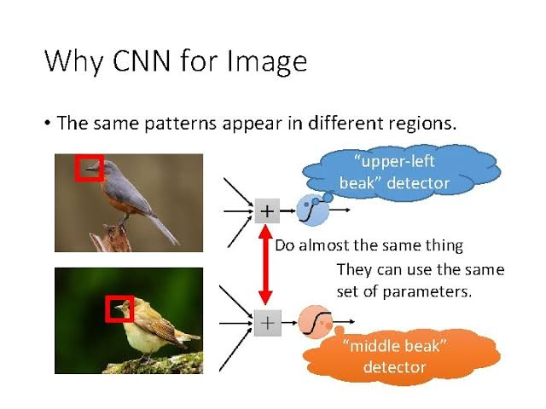

Slide 3
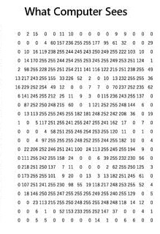
WHAT COMPUTER SEES: Dimensions of array is 60*60*3 3 refers to RGB values Each of these numbers given a value between 0 to 255 which defines the intensity at that point.

Slide 4
There are three types of convolutional layers in neural networks
CONVOLUTIONAL LAYER
RELU LAYER
POLLING LAYER

Slide 5
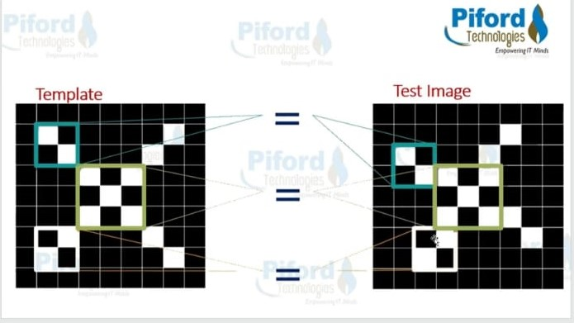
In CNN images are not matched pixel by pixel rather they are matched by features.

Slide 6
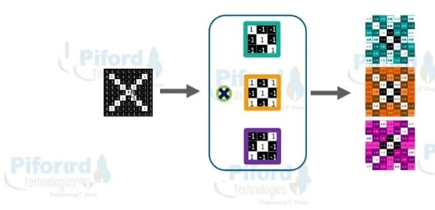
1) Convolutional layer:1 image become stack of filtered images and the no of filtered images depends upon the number of filters we are using.

Slide 7
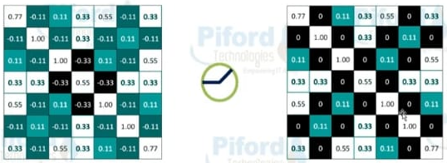
2)RELU LAYER : In this layer we remove all negative values from the filtered images and replace it with zero’s.

Slide 8
3)pooling: pooling is used to shrink the size of the images.
Steps:
Pick a widow size
Choose stride(by how much amount we want to shift the image downwards ).
Pass the window across the filtered images.
From each window take the maximum values.

Slide 9
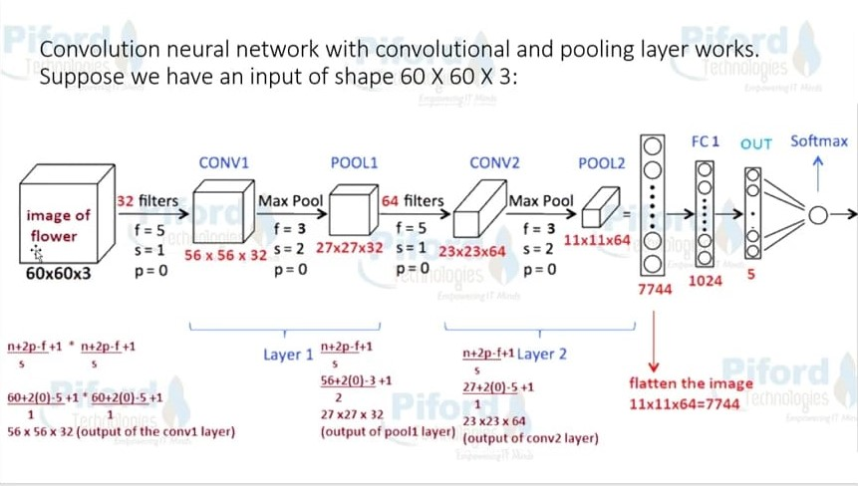

Slide 10
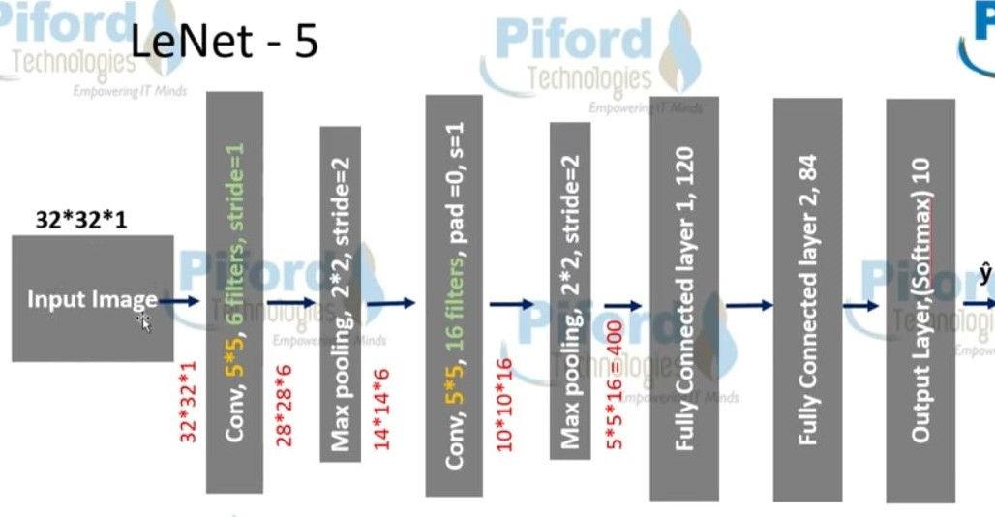
NETWORKS WE GOING TO DISCUSSED ARE:
Lenet : The convolutional and fully connected layers as weight layers because they contain trainable weights as opposed to pooling layers that don’t contain any weights. The common convention is to use the number of weight layers to describe the depth of the network.
LeNet architecture :

Slide 11
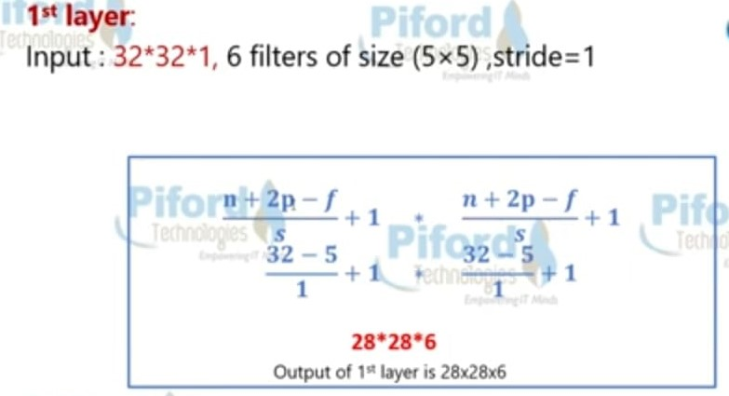
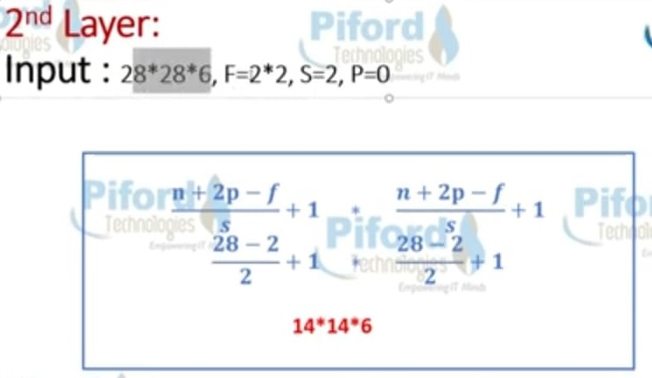
INPUT IMAGE ⇒ C1 ⇒ TANH ⇒ S2 ⇒ C3 ⇒ TANH ⇒ S4 ⇒ C5 ⇒ TANH ⇒ FC6 ⇒ SOFTMAX7 where C is a convolutional layer, S is a subsampling or pooling layer, and FC is a fully connected layer.

Slide 12
AlexNet has a lot of similarities to LeNet but is much deeper (more hidden layers) and bigger (more filters per layer). They have similar building blocks: a series Of convolutional and pooling layers stacked on top of each other followed by fully connected layers and a softmax. It was permored on Imagenet(datset of over 15 million labelled high resolution images belong to 22000 different categeories.
2)ALEXNET:

Slide 13
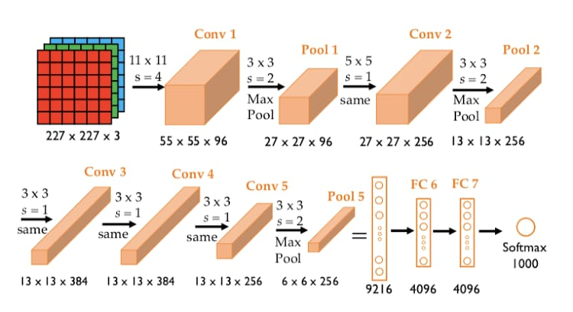
Alexnet architecture:

Slide 14
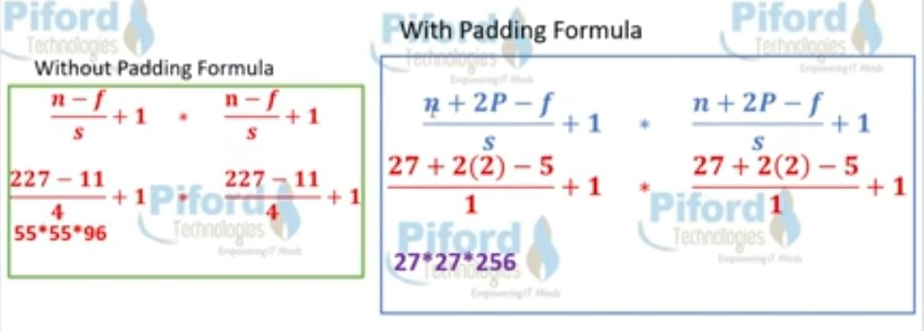

Slide 15
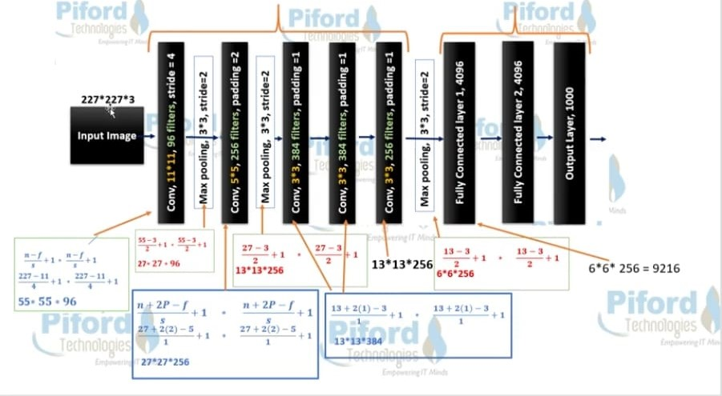

Slide 16
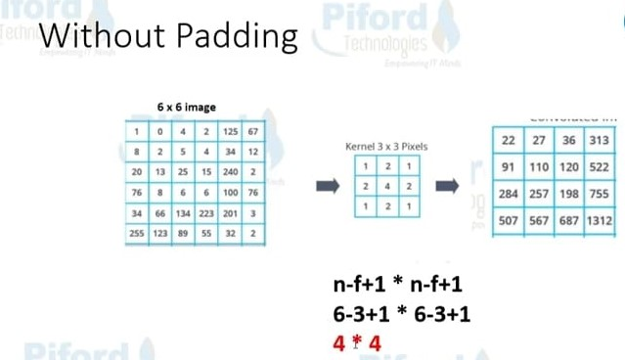
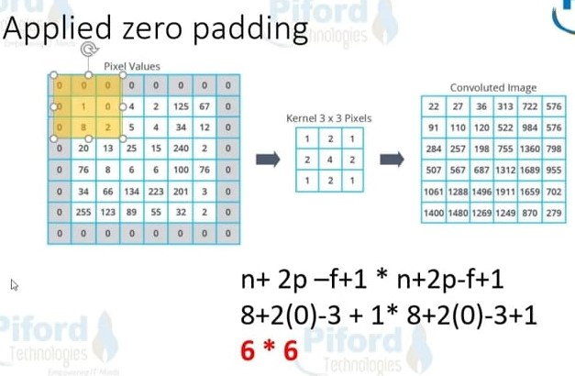

Slide 17
DROPOUT LAYER:
dropout layers are used to prevent the neural network from overfitting.
The neurons that are “dropped out” do not contribute to the forward pass and do not participate in backpropagation. This means every time an input is presented, the neural network samples a different architecture, but all of these architectures share the same weights.
This technique reduces complex co-adaptations of neurons, since a neuron cannot rely on the presence of particular other neurons

Slide 18
3)VGGNet :
VGGNet was developed in 2014 by the Visual Geometry Group at Oxford University (hence the name VGG).3 The building components are exactly the same as those in LeNet and AlexNet, except that VGGNet is an even deeper network with more convolutional, pooling, and dense layers.
Novel features of VGGNet:It improves on AlexNet by replacing large kernel-sized filters (11 and 5 in the first and second convolutional layers, respectively) with multiple 3 × 3 pool-size filters one after another.
Architecture of VGGNET:
The architecture is composed of a series of uniform convolutional building blocks followed by a unified pooling layer, where:
○ All convolutional layers are 3 × 3 kernel-sized filters with a strides value of 1 and a padding value of same.
○ All pooling layers have a 2 × 2 pool size and a strides value of 2

Slide 20
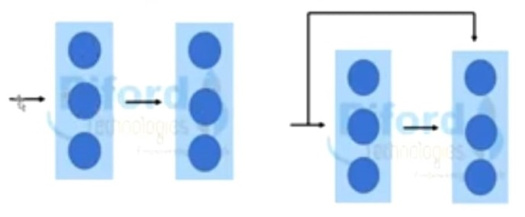
4)ResNet :
Deep networks are hard to train because of vanishing gradient problem. To solve this problem we use resnet.
Resnet introduced the concept of skip connection .
Add the original input to the ouput of convolution layer.

Slide 21
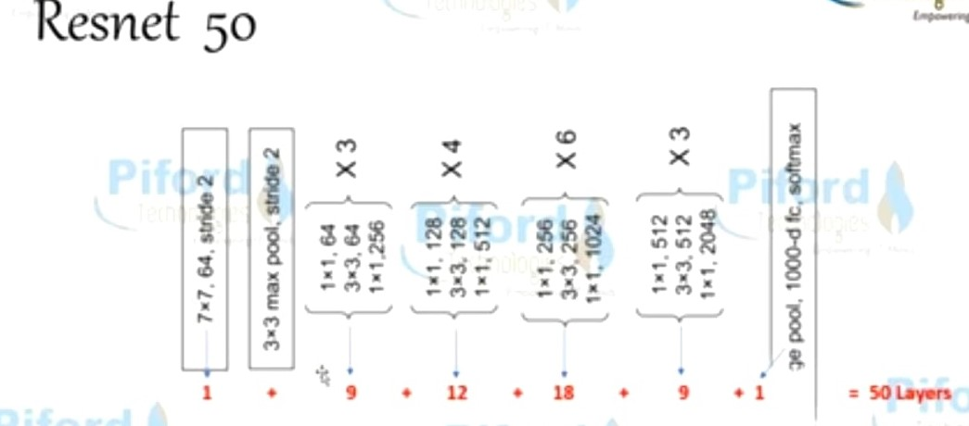

Slide 22
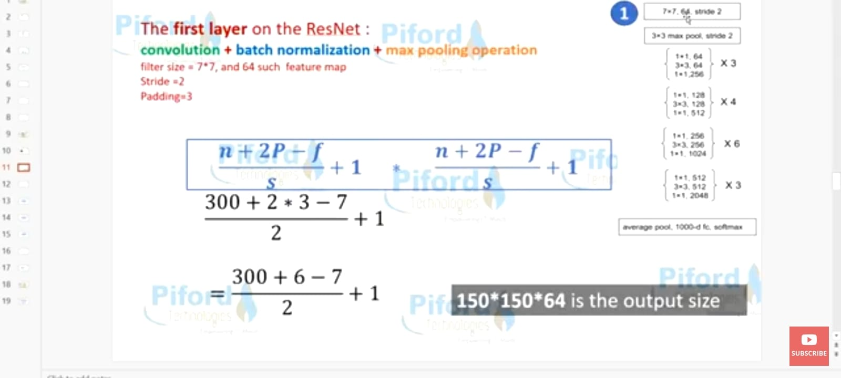

Slide 23
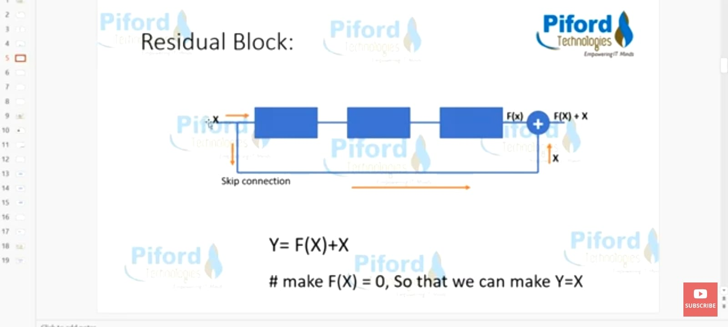

Slide 24
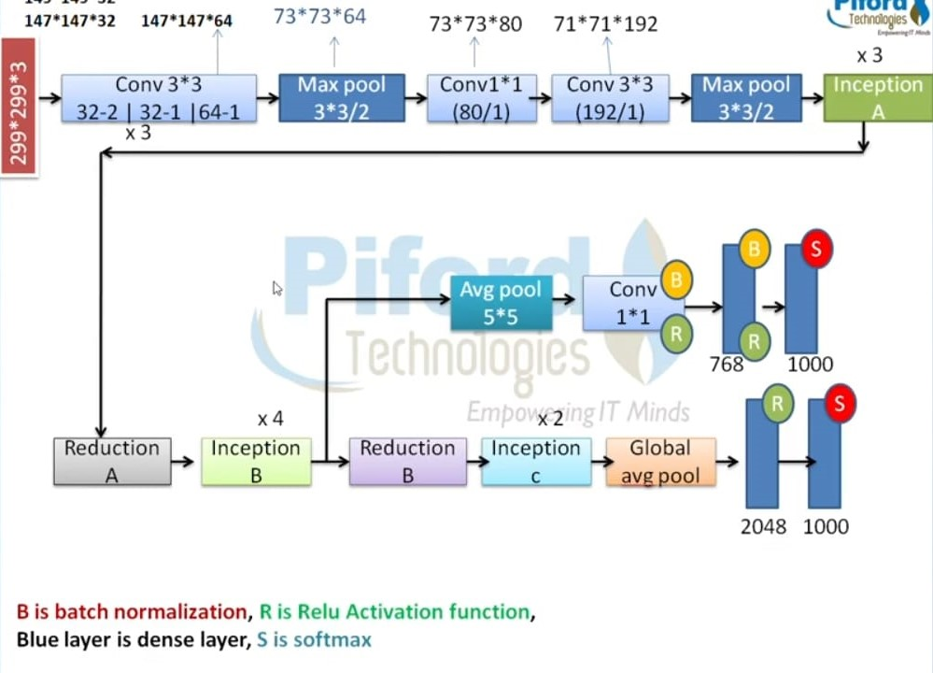
5)Inceptionv3:The Inception network came to the world in 2014 when a group of researchers at Google published their paper, “Going Deeper with Convolutions.”4 The main hallmark of this architecture is building a deeper neural network while improving the utilization of the computing resources inside the network. Architecture:

Slide 25
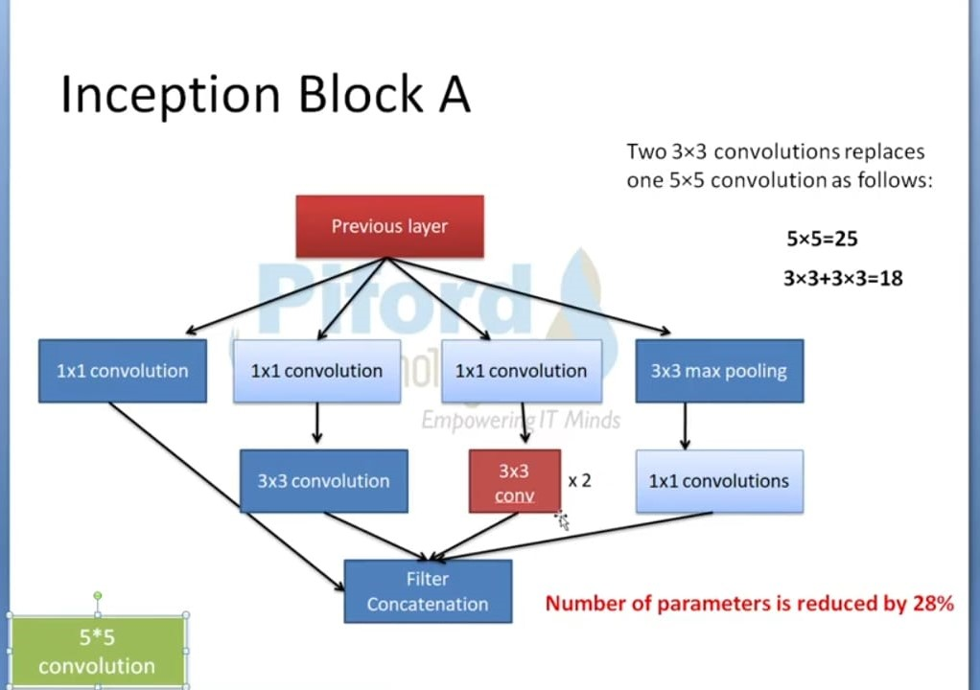

Slide 26
THANK YOU
ZEENAT WASEEM
ROLLNO:21
ASSIGNMENT
MACHINE LEARNING(204)
JAMIA MILLIA ISLAMIA

